Slide 1
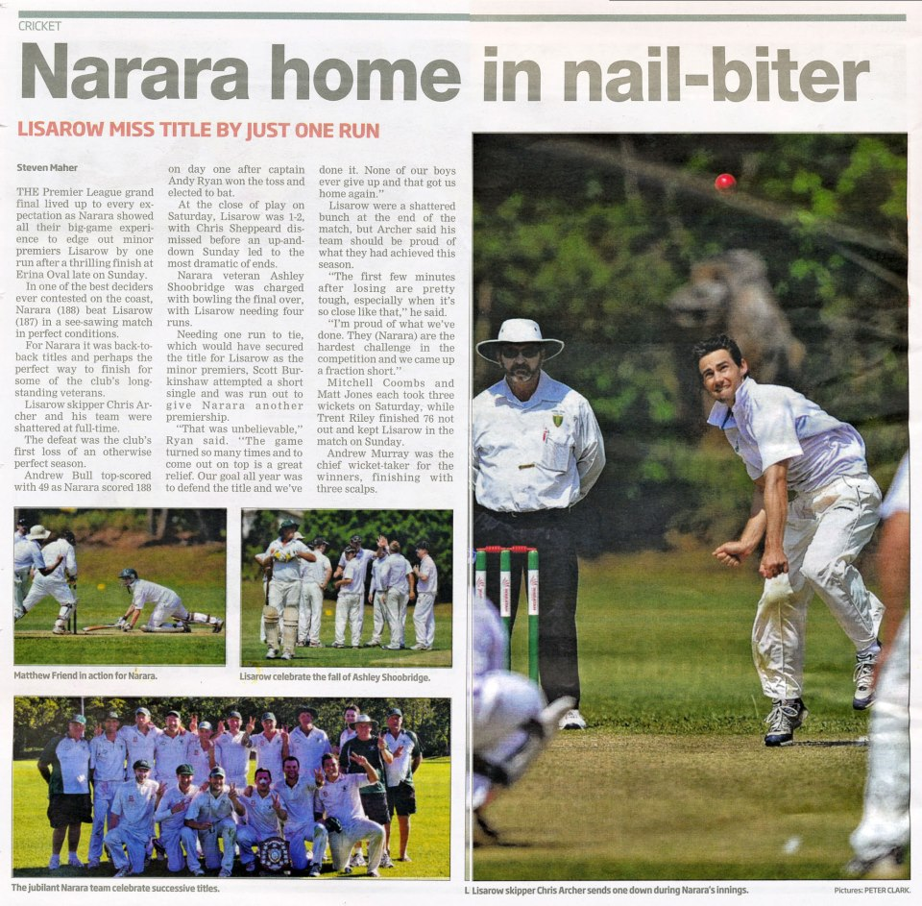

Slide 2
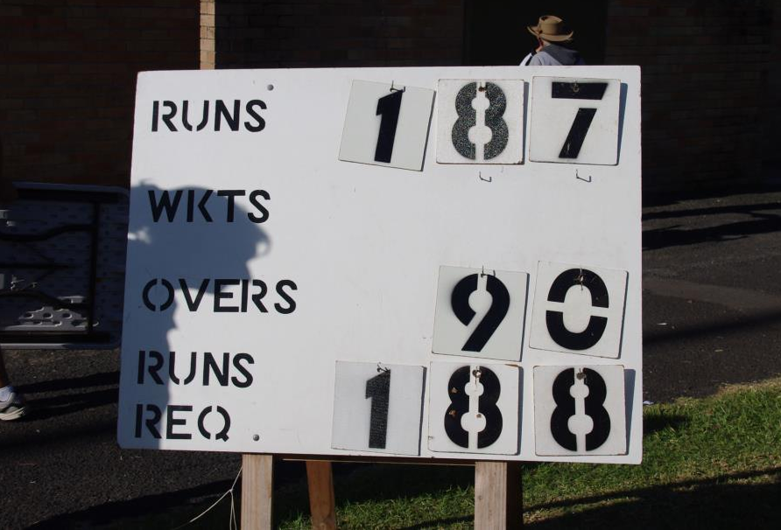

Slide 3
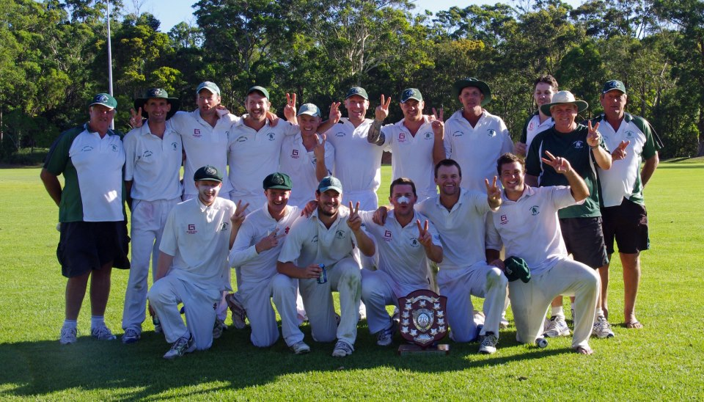
VICTORY – two in a row!!

Slide 4
Premier League Captain
Andy ‘Rhino’ Ryan
Opening Bowler
Versatile Batsman
Freakish Fielder
Best Bloke Ever
Season 2012/13
Runs 193
Highest Score 56
Wickets 34
Best Bowling 7/21
Catches 14
We did it again lads!!!!

Slide 5
Matthew ‘Bartolo’ Friend
Top Order Batsman
Occasional Bowler
Handy Fielder in Grand Finals!!
Favourite Quotes:
“That’s Six!” “Bowled his @r$e”
Season 2012/13
Runs 218
Highest Score 52
Wickets 1
Best Bowling 1/12
Catches 2
Run Outs 1
Bez: ‘Don’t run on Bart’s arm!!’

Slide 6
Ben ‘Cranky’ Surwald
Medium Pace Bowler
Magic wrists - when he gets it right, he can make the ball talk.
“Sherriff Woody makes sure
no one poisons the waterhole”
Season 2012/13
Runs 84
Highest Score 25
Wickets 6
Best Bowling 5/34
Catches 2

Slide 7
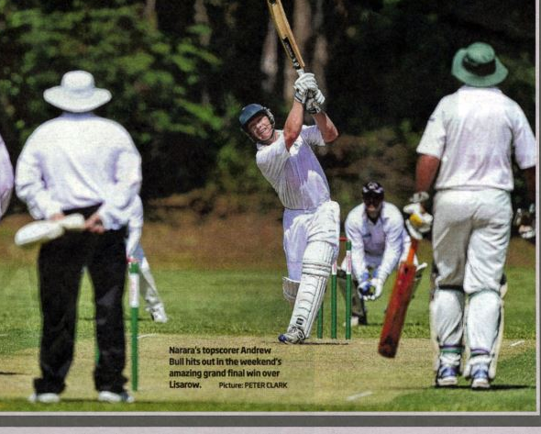
Andrew ‘Bullbar’ Bull
Top order batsman
“Best calves in the world”
Season 2012/13
Runs 361
Highest Score 66
Catches 6
“Two ugliest shots I played all year made the paper.”

Slide 8
Dane ‘Hulk’ Hokin
Entertaining Batsman
Reliable Keeper
Best team man and battled on
through injury without complaint!
Season 2012/13
Runs 198
Highest Score 62
Catches as Keeper 2
Stumpings 2

Slide 9
Troy ‘Rabs’ Marchant
Opening Batsman
Talkative Fielder
Tried to punch on with an unnamed Magpie, then had the nerve to try and sign his Grandfather as a client!
Season 2012/13
Runs 157
Highest Score 33
Catches 4

Slide 10
Andrew ‘Poppy’ Murray
Strike Bowler
191 Overs & 60 Maidens!!!
Reliable Batsman
Season 2012/13
Runs 120
Highest Score 52
Wickets 32
Best Bowling 7/46
Catches 4
To this day he still bowls with very heavy balls!

Slide 11
Tony ‘Glue’ Cornwell
Middle Order Batsman
Outstanding Fieldsman
Season 2012/13
Runs 136
Highest Score 35
Catches 2
Run Outs 2
How did he become ‘Glue’?
Legend has it that the Div 1 lads thought he needed
a name that would stick. Tommy Head was heard to stay ‘glue sticks’.
So ‘Glue’ it is.

Slide 12
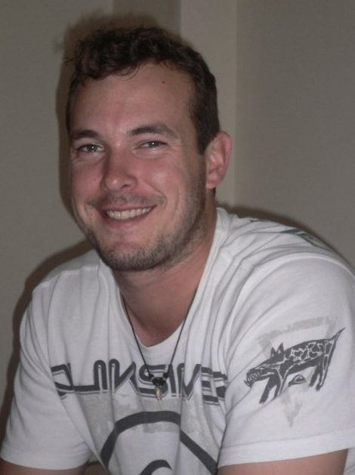
Mark ‘Spanner’ Smith
Rumour has it that ‘Scuba Steve’ may also go by the names: Frank Drebbin or
Enriquo Fellazzo!!??
Strike Bowler
Handy Batsman
Season 2012/13
Runs 134
Highest Score 36
Wickets 20
Best Bowling 6/18
Catches 2

Slide 13
Ashley ‘Shoe’ Shoobridge
Season 2012/13
Runs 189
Highest Score 74
Wickets 23
Best Bowling 4/29
Catches 4
Final against Terrigal
Terrigal Supporter - “What happened to you blokes?”
Terrigal Player – “Shoobridge”!!

Slide 14
Mark ‘Macca’ McLachlan
Top Order Batsman
Classiest Batsman since Lara (Brian, not Bingle)!
Season 2012/13
Runs 152
Highest Score 75
Catches 1

Slide 15
Adam ‘Adman’ Walsh
Outstanding Batsman
Excellent Fielder
Dug us out of our deepest holes this year
and battled on with a crippling knee injury
Season 2012/13
Runs 391
Highest Score 85
Wickets 2
Best Bowling 1/11
Catches 8
Run Outs 1

Slide 16
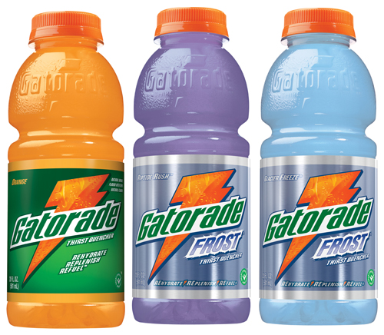
KJ & Lul
12th and 13th Man
Two young Lion Cubs who would do anything for the boys in green. Even provided Grand Final night seating when all other spots were taken.

Slide 17
Managed not to receive 2nd degree burns from a meat pie this year.
Renowned expert on Finger Web Spiders and rare Ciders.
Coach
Glenn ‘Snoopy’ Rowlands

Slide 18
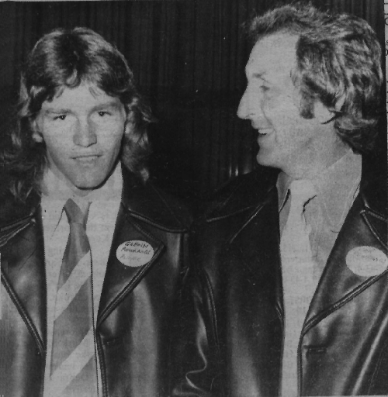
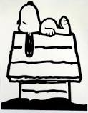
How did Glenn ‘Snoopy’ Rowlands get his name?
The son of off-spinner Eric Rowlands he regularly took the field as a substitute fieldsman in first grade where his ploy of hiding behind the bowler as he ran in and popping his head out as the ball was bowled earned him the nickname ‘Snoopy’.

Slide 19
Spectator: “Smithy you keep a very neat score book.”
Smithy: “ Well I did go to school you know.”
Smithy
Looking forward to reacquainting himself with his new best mate, Stat, the Doylo scorer.

Slide 20
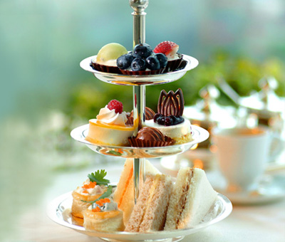
Di Smith
Afternoon tea Extraordinaire !!!!!
Lost all her fingernails due to nerves whilst watching the Grand Final.

Slide 21
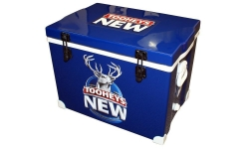
Can supply a quality ‘Morterade’
to a thirsty bowler or batsmen and always accommodating of
players’ peculiar drink
choices!
John ‘Mort’ Mortimer, Team Manager

Slide 22
Rob Cross
Curator Gavenlock Oval
Thanks to all Rob’s hard work this season The ‘G’ is now regarded as one of the best grounds on the coast.

Slide 23
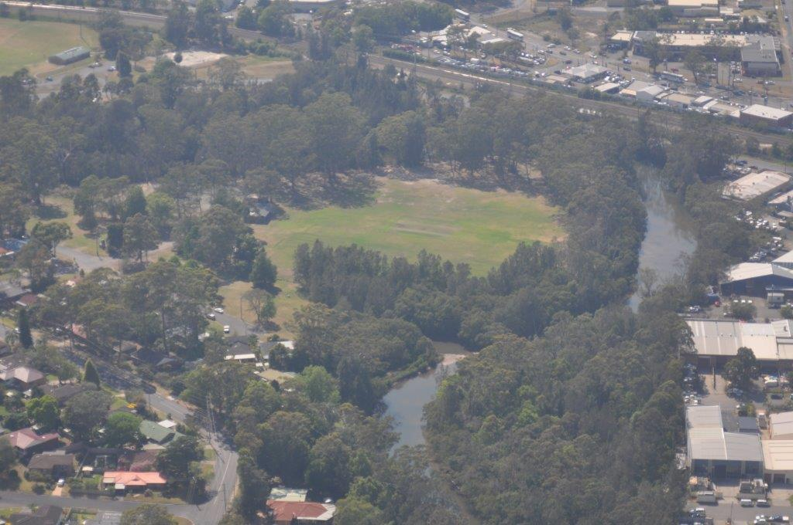
Gavenlock Oval - The ‘G’
Home of Mighty The Lions

Slide 24
Notes:
Third last slide

Slide 25
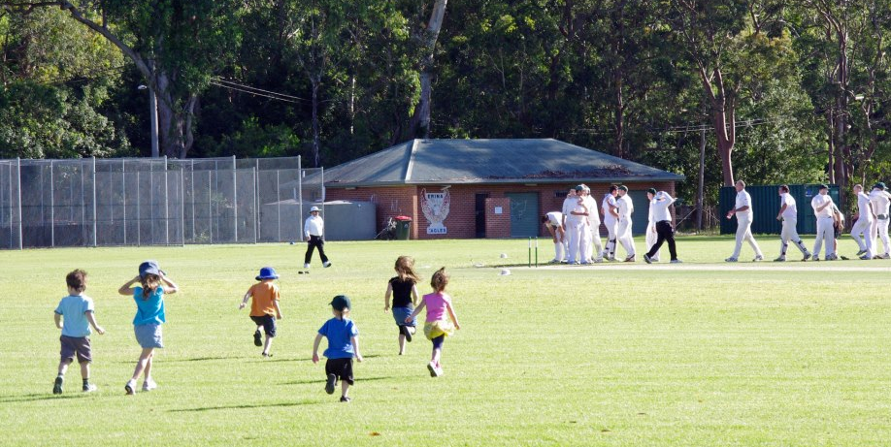
***AND THE FANS GO WILD***

Slide 26
GLORY GLORY TO NARARA ........

Slide 27
Many thanks to the following people that
contributed to the compilation of this slide show:
Rob Cross – Photography
Al Kennedy – Photography
Adam Walsh – Photography
Rob Ness – Sound
Andrew Bull – Comments and quotes
Andy Ryan – Comments.
Sue Jordan

